Slide 1
Automated Podcast Transcription & Topic Segmentation
AI-based Speech-to-Text and NLP-driven Content Analysis System
By Pavan Kumar Mathurthi
Infosys Springboard Virtual Internship 6.0
Guide: Gowtham Deepu
This project automates podcast transcription and segments content into meaningful topics using AI, making audio data searchable and analyzable.

Slide 2

Problem Statement
Unstructured Audio Data
Podcasts generate vast amounts of unstructured audio, making content difficult to manage.
Manual Transcription
Traditional transcription is time-consuming, expensive, and prone to human errors.
Content Analysis Gap
Existing tools struggle with searching, analyzing, and reusing podcast content effectively.
Lack of Segmentation
Current solutions often lack topic-level segmentation, hindering deeper insights.
This project addresses the critical need for efficient podcast content management in real-world scenarios, transforming raw audio into actionable data.

Slide 3

Objectives
Automate Transcription
1
Develop an automated system for accurate podcast audio transcription.
Segment Topics
2
Implement methods to segment transcripts into meaningful, coherent topics.
NLP Analysis
3
Apply Natural Language Processing techniques for structured content analysis.
Scalable Architecture
4
Design a scalable and reusable backend architecture for broad application.
Our goal was to transform raw podcast audio into structured, analyzable data, enabling new possibilities for content discovery and reuse.

Slide 4





Proposed Solution
Automated Pipeline
An end-to-end processing pipeline for podcast content.
Offline Speech Recognition
Robust speech recognition for accurate transcription without internet dependency.
NLP Topic Analysis
Advanced NLP for topic segmentation and deeper content insights.
REST API Backend
A flexible, accessible backend system via a RESTful API.
Our solution provides a comprehensive, high-level approach to transforming unstructured podcast audio into structured, analyzable data.

Slide 5

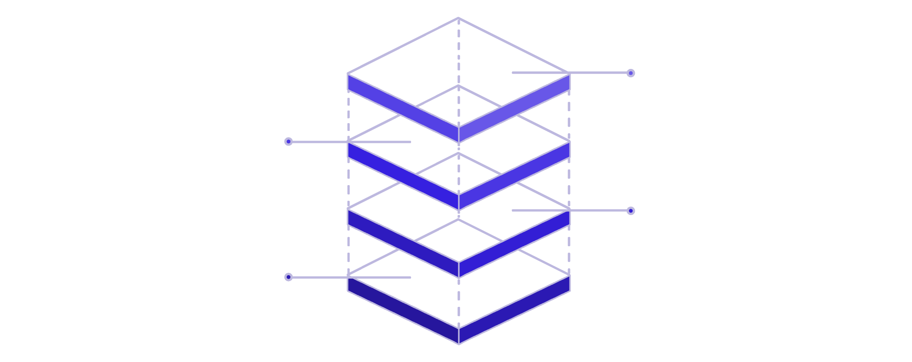
System Architecture
Database
MongoDB storage and retrieval
AI Processing
Python ML inference layer
Backend API
Node.js + Express endpoints
Frontend
React.js user interface
The architecture is designed for clear data flow, starting from the user interface, through the API, to the AI processing, and finally to the database for storage and retrieval.

Slide 6


Workflow / Approach
Audio Upload
Users upload podcast audio files to the system.
Preprocessing
Audio undergoes noise reduction and enhancement.
Transcription
Speech-to-text engine converts audio to text.
Text Segmentation
Transcripts are segmented into distinct topics.
NLP Analysis
NLP techniques extract insights and structure data.
Store & Return
Results are stored and made available via API.
This step-by-step pipeline ensures a systematic and efficient transformation of raw audio into structured, analyzable content.

Slide 7
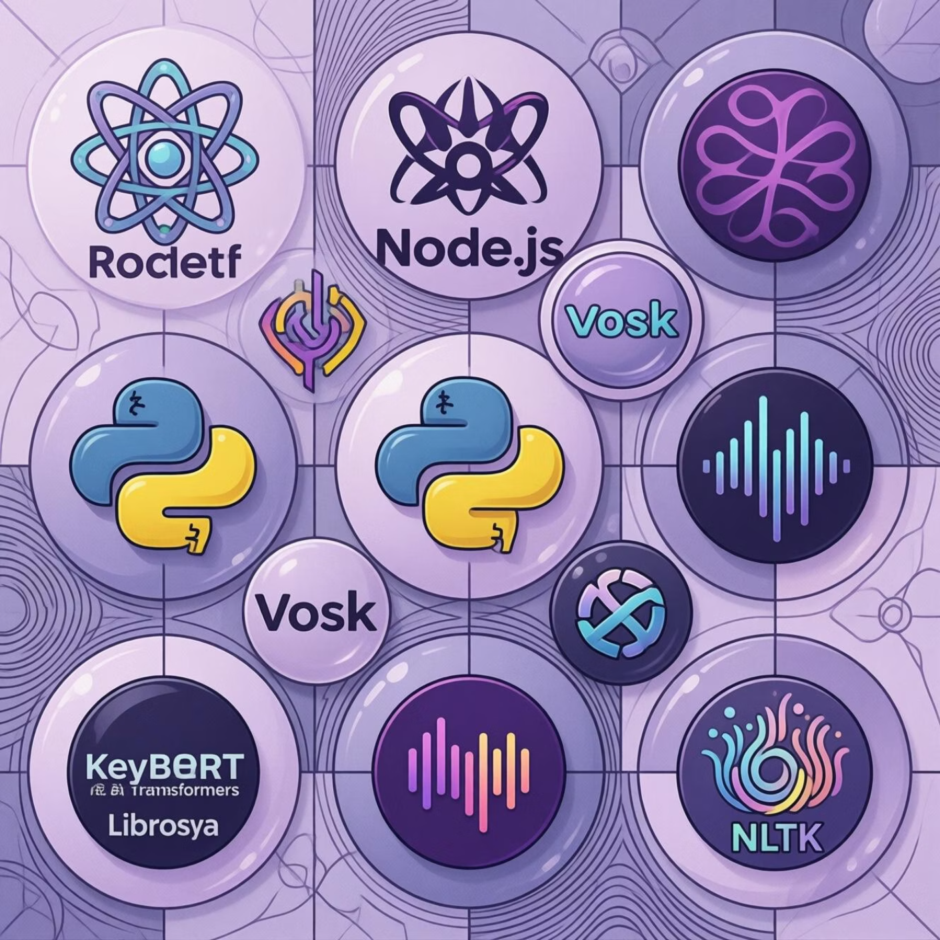
Tech Stack
Frontend
React.js: For a dynamic and responsive user interface.
Backend
Node.js, Express: Powering the robust and scalable API.
Core Processing
Vosk (ASR): Offline speech recognition for accuracy.
Transformers, KeyBERT: Advanced NLP for topic segmentation and keyword extraction.
Librosa, NLTK: For audio preprocessing and natural language toolkit functionalities.
Database
MongoDB: Flexible NoSQL database for storing unstructured and structured data.
These technologies were chosen for their efficiency, scalability, and suitability for AI-driven audio and text processing.

Slide 8





Key Features
Automated Transcription
Topic Segmentation
Noise Reduction
Converts audio to text efficiently and accurately.
Breaks down content into logical, timestamped topics.
Enhances audio quality for improved transcription accuracy.
REST API Integration
Modular & Scalable
Enables seamless integration with other applications.
Designed for easy expansion and handling large volumes of data.
These features make the project a powerful tool for anyone looking to unlock the value of podcast content.

Slide 9



Dataset / Input
Podcast Audio Files
Variable Duration
Accepts common formats like WAV and MP3.
Handles audio samples of varying lengths, from short clips to full episodes.
The system is designed to process real-world conversational podcast content, ensuring practical applicability and robust performance.

Slide 10
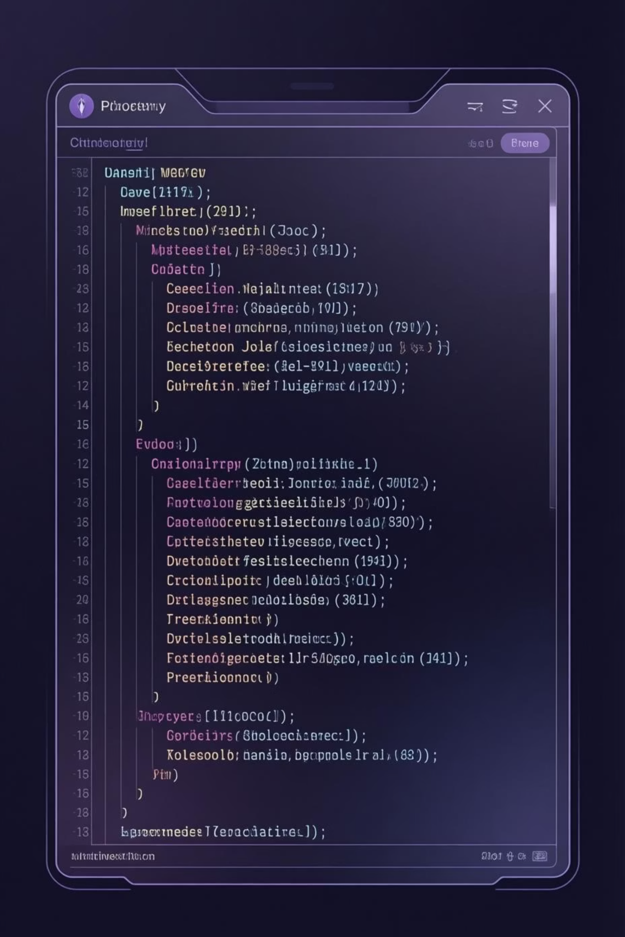
Output / Results
1
Accurate Transcripts
High-fidelity text versions of the audio content.
2
Segmented Topics
Content broken down into logical topics with precise timestamps.
3
Structured JSON
Output provided in a machine-readable JSON format for easy integration.
4
Ready for Analysis
Results are immediately usable for further data analysis and insights.
The final output provides users with structured, actionable data, ready for advanced analysis or integration into other platforms.

Slide 11

Testing & Validation
Unit Testing for Core Modules
Testing individual components for correctness
Integration Testing for Pipeline
Verifying seamless data flow across all stages
Mocking External Dependencies
Isolating components to test in controlled environments
Performance Evaluation
Benchmarking on multiple audio samples of varying lengths
Comprehensive testing ensured system reliability, accuracy, and robustness across diverse podcast content.

Slide 12

Performance & Observations
Processing Time Dependency
Noise Reduction Impact
Noise reduction significantly improves transcription accuracy and output quality
Processing time depends on audio duration and system resources
Memory Considerations
Longer podcasts require higher memory usage for processing and storage
Key observations during development revealed important performance characteristics that inform deployment and scaling strategies.

Slide 13
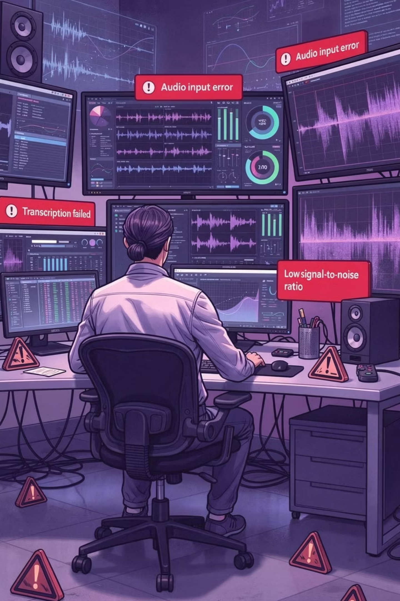
Limitations
Audio Quality Dependency
Topic Segmentation Challenges
Transcription accuracy is significantly affected by poor audio quality, background noise, and speaker clarity
Topic segmentation may miss contextual nuances and struggle with overlapping or ambiguous topic boundaries
Resource Constraints
High memory usage for processing long audio files limits scalability on resource-constrained systems
Acknowledging these limitations is crucial for realistic deployment expectations and guides future improvements to the system.

Slide 14
Conclusion
Automated Transcription System
Reduced Manual Effort
Successfully built an end-to-end automated system for podcast transcription
Significantly reduced manual effort and time required for podcast analysis and content management
Practical AI Implementation
Scalable Foundation
Demonstrated practical use of ASR (Automatic Speech Recognition) and NLP techniques in real-world scenarios
Established a scalable foundation for future enhancements and broader applications
This project successfully transforms raw podcast audio into structured, analyzable data, proving the viability of AI-driven content automation and opening doors for future innovations in audio processing and analysis.

